Slide 1
Information Retrieval
Assignment 4 Browsing Models
Presented by: M. Umair Shahid [2021-CS-144]
Instructor: Dr. Khaldoon Syed Khurshid
Department of Computer Science University of Engineering and Technology Lahore

Slide 2

Goal Definition
Problem Statement: Navigating vast content is challenging; users need effective tools to find, access, and engage with information.
Structure Guided Browsing (SGB): Hierarchical navigation for structured exploration.
Hypertext Model: Interconnected navigation for dynamic, non-linear access.
Real-World Analogy:
SGB is like an organized library with a clear catalog system.
Hypertext is like to jumping between linked articles on Wikipedia.

Slide 3
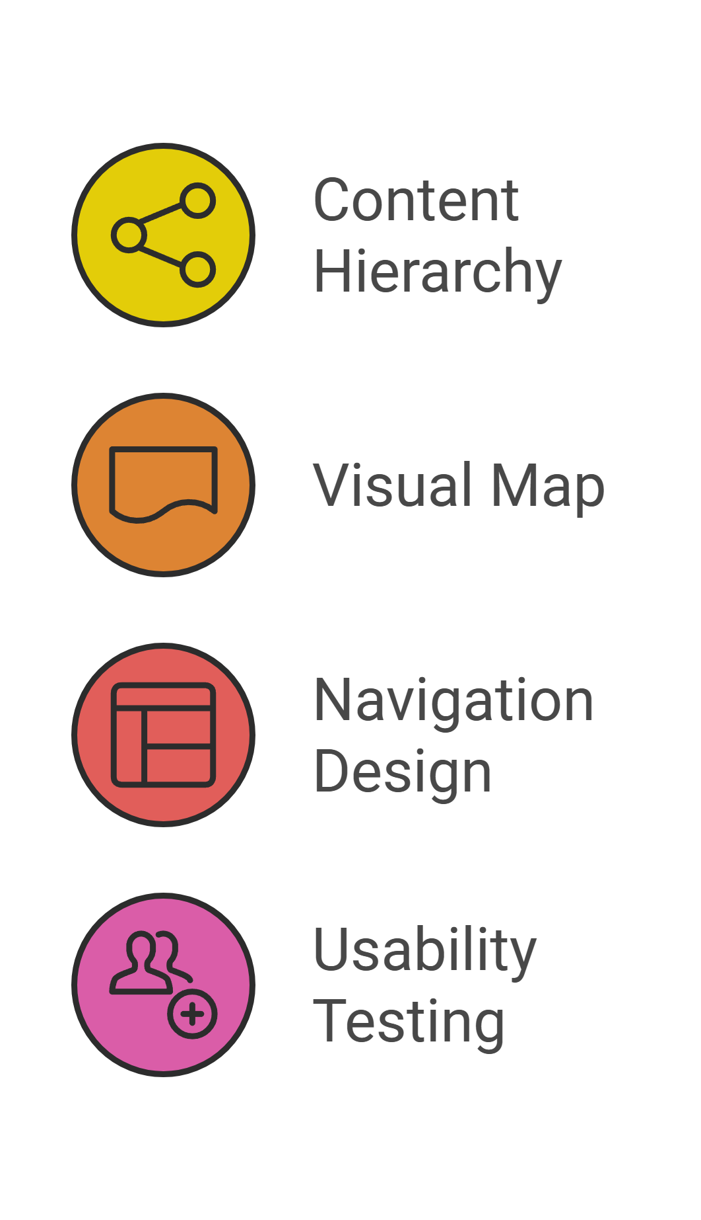
Structure Guided Browsing(SGB)
Steps:
Define a content hierarchy (e.g., categories, subcategories).
Create a visual map (like a family tree).
Implement intuitive navigation (menus, collapsible sections).
Test usability and gather feedback.
Example:
Udemy-style hierarchical tree: Categories like "Programming" → "Web Development" → "HTML Basics.“
Tree-like GUI for browsing courses and their details.
Real-World Analogy:
Similar to finding books by genre and subgenre in a bookstore.

Slide 4
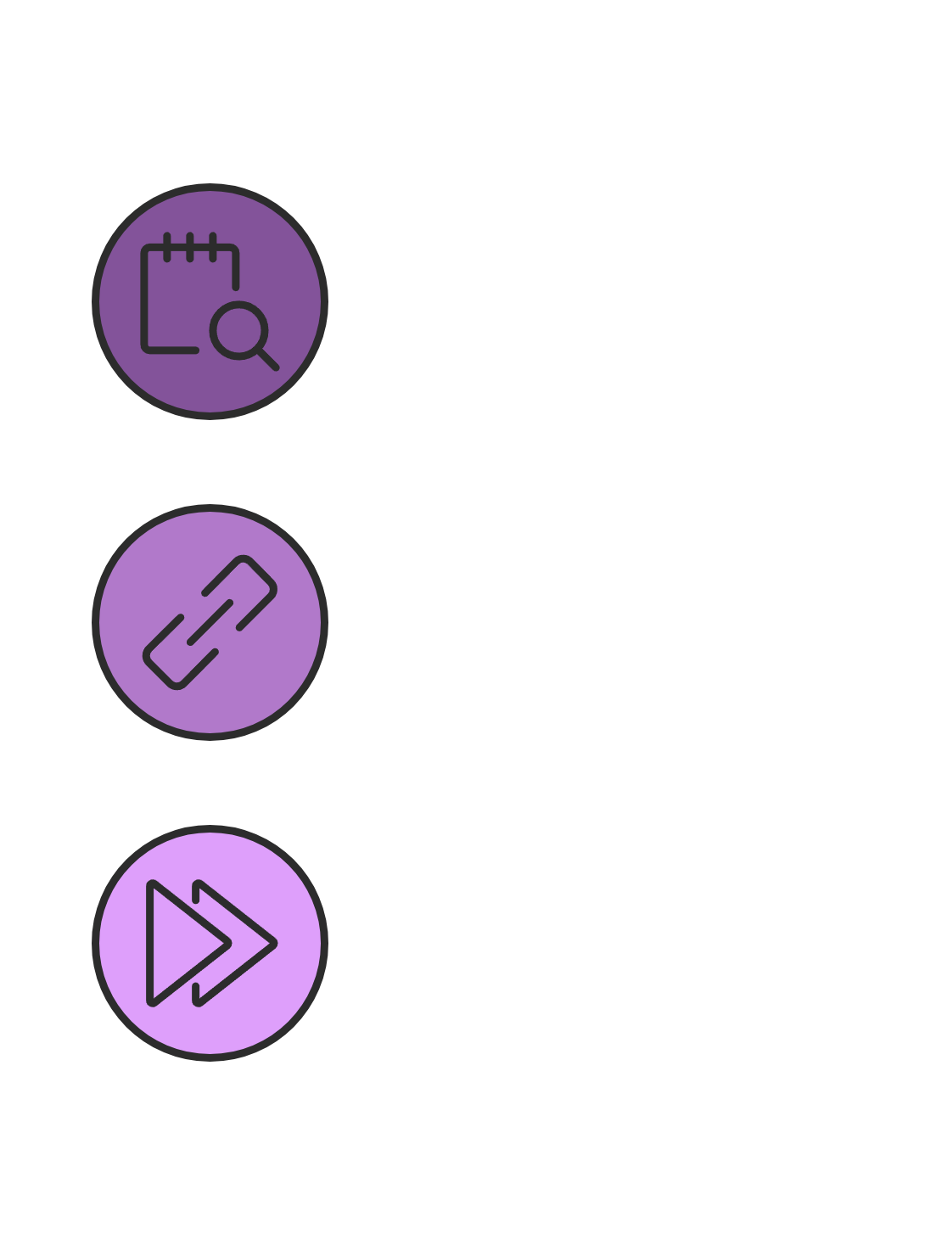
Hypertext Model
Steps:
Identify content nodes (chapters, articles).
Create links between related nodes.
Enhance navigation with features like search, back buttons.
Example:
Sherlock Holmes e-book: Chapters linked for seamless transitions.
Features like search, back button, and highlighted links.
Real-World Analogy:
Hypertext is like exploring linked news articles on a website.

Slide 5
Impact and Future Prospects
Benefits:
Faster, easier access to information.
Enhanced user engagement and experience.
Applications:
Educational platforms, online libraries, research tools.
Real-World Analogy:
Like upgrading from static road maps to dynamic GPS systems..

